Slide 1

ECE 802, Electric Motor Control
Permanent-Magnet
Ac Machines

Slide 2
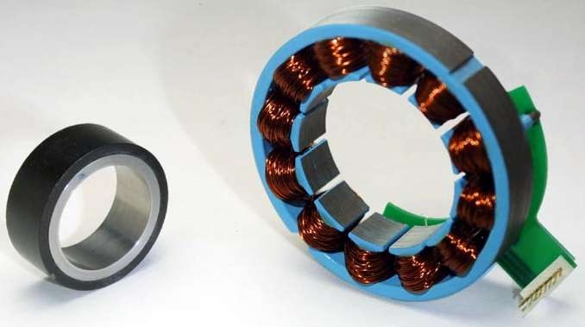
Rotor and Stator

Slide 3
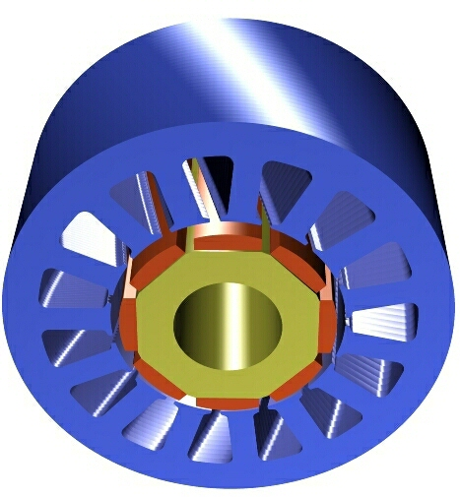
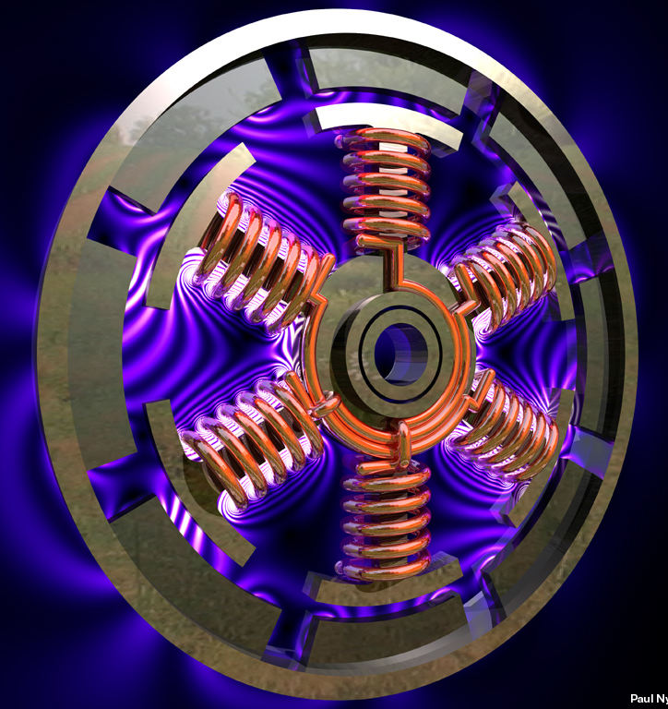
Rotor and Stator Designs

Slide 4
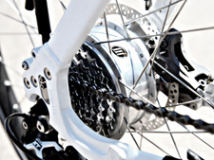
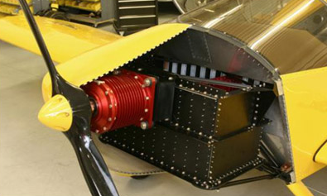
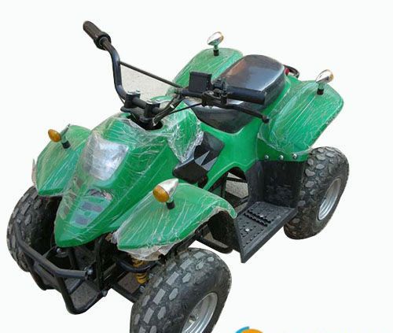
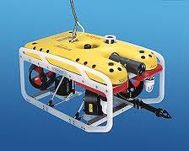
Some Applications
Electric bike
Electric airplane
Remote operated vehicle
All-terrain vehicle

Slide 5
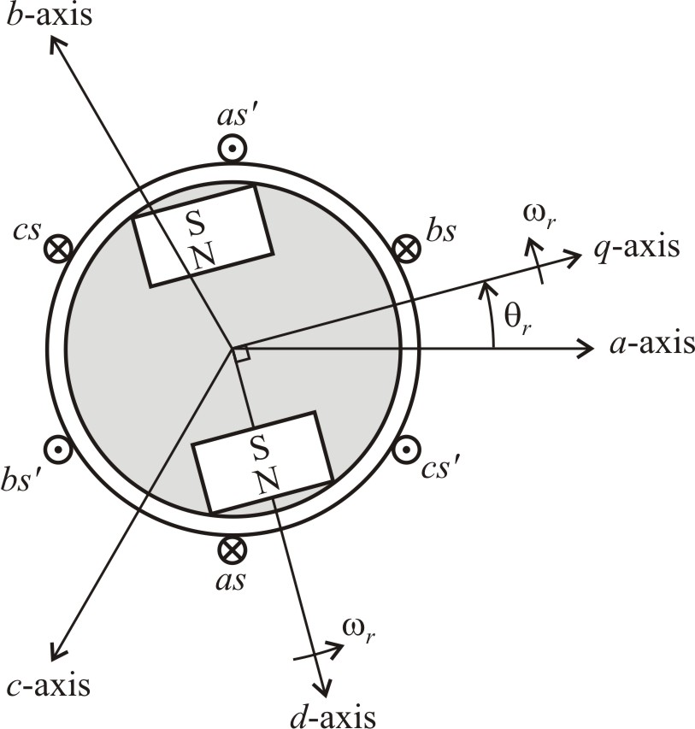
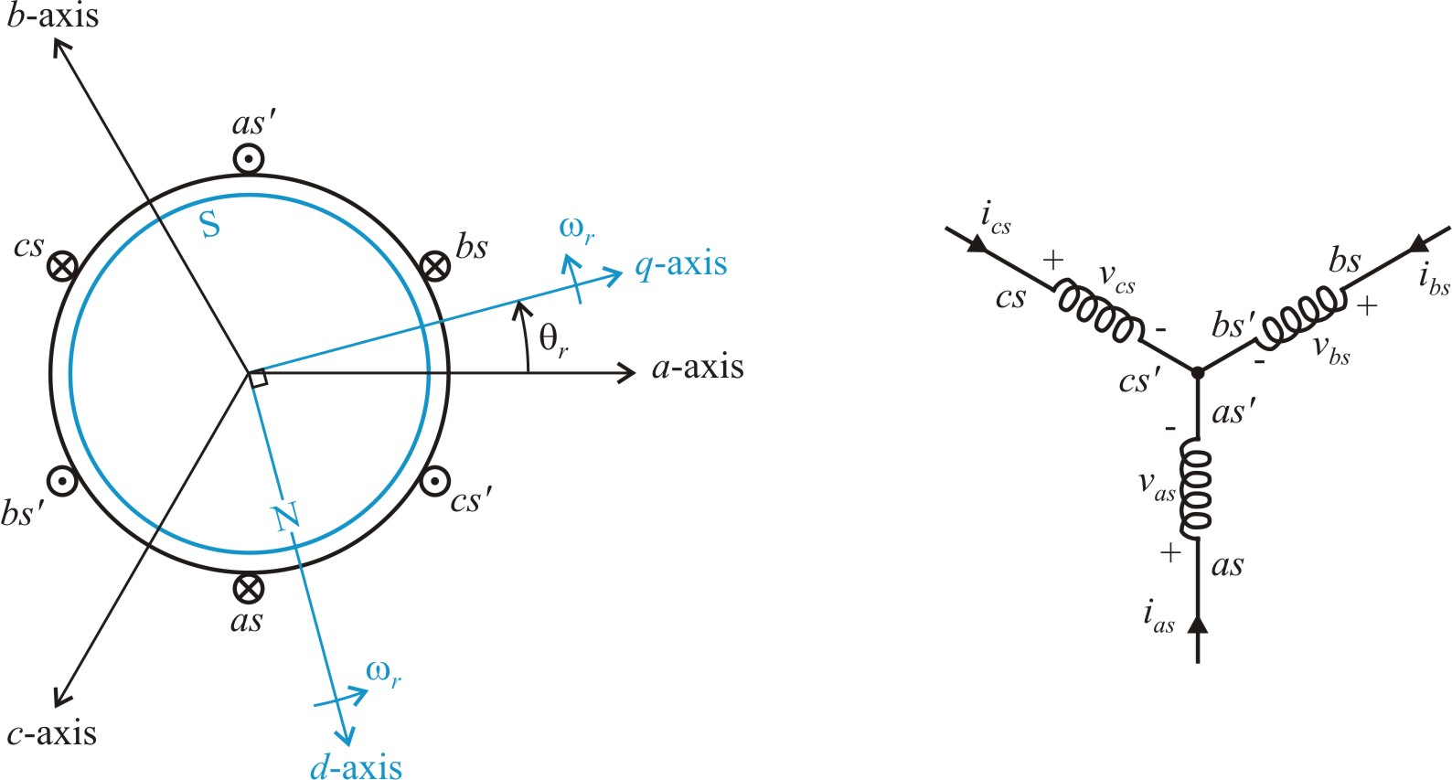
Permanent-Magnet Ac Machines
winding connection
motor construction

Slide 6
PMSM Equations
voltage equations
flux linkages

Slide 7
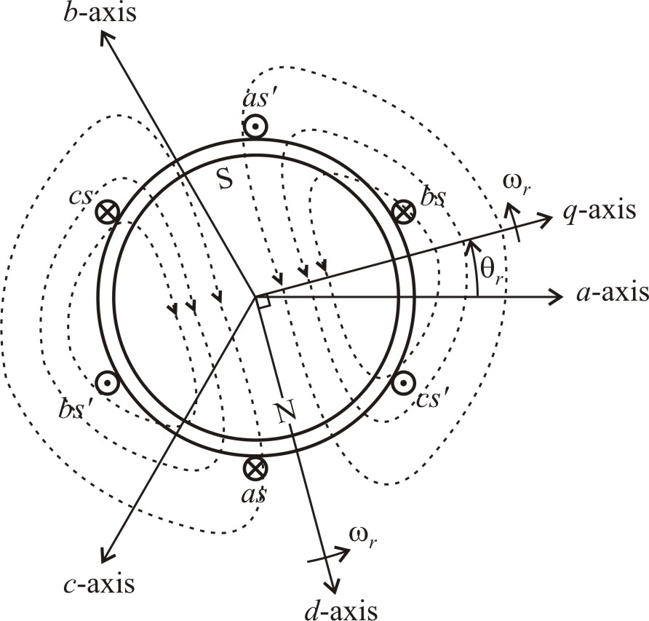
Magnet Flux
magnet flux linking the a-phase

Slide 8
Transform Voltage Equations
machine variables
rotor reference frame, q-d variables

Slide 9
Transform Flux Linkage Equations
inductance
where
magnet flux linkage

Slide 10
Flux Linkage Equations in the Rotor Reference Frame
where
compared to a-b-c variables:
no coupled terms and no rotor position dependence

Slide 11
Equivalent Circuit Model
substitute flux linkage equations into voltage equations

Slide 12
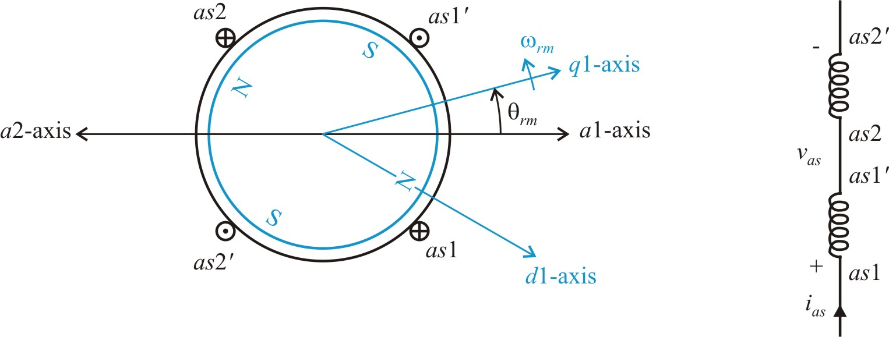
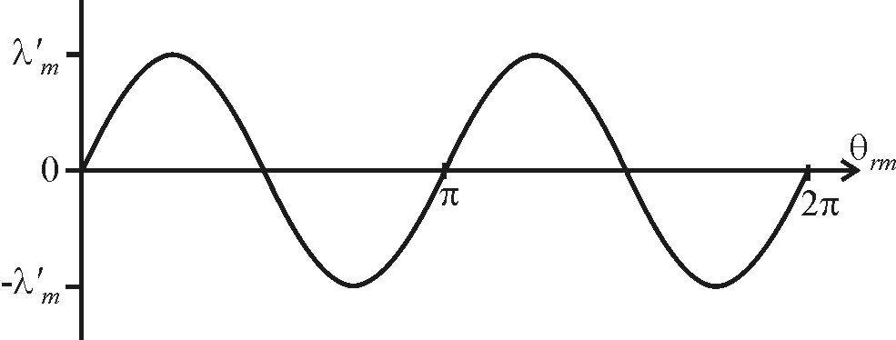
Four-Pole PMSM
plot a-phase flux linkage from the rotor magnet
Note: One cycle of θ_{rm} is two cycles of θ_{r}

Slide 13
General Machine with P Poles
θ_{r} - electrical rotor position (rad)
θ_{rm} - mechanical rotor position (rad)
ω_{r} - electrical rotor speed (rad/sec)
ω_{rm} - mechanical rotor speed (rad/sec)

Slide 14
Torque Equation from Power

Slide 15
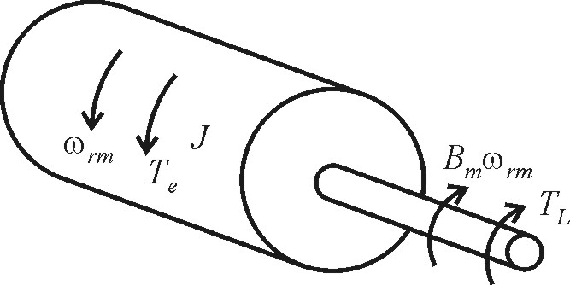
Mechanical Equations
also
T_{e} - electrical torque (N∙m)
B_{m} - friction constant (Kg∙m²/sec)
J - total inertia (Kg∙m²)
ω_{rm} - mechanical speed (rad/sec)
T_{L} - load torque (N∙m)
θ_{rm} - mechanical rotor position (rad)

Slide 16
Round Rotor Permanent-Magnet Ac Machines
winding connection
motor construction

Slide 17
Round Rotor Machine Equations

Slide 18
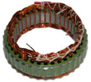

Inductance Related to Machine Dimensions
From Chapter 1 and 2

Slide 19
PMSM Model
If the zero sequence current can be neglected, the q-d model represents the machine as a two-phase circuit with dc quantities in the steady-state. The two circuits are coupled by back-emf terms.
The torque equation in the q-d model is simplified compared to the machine-variable (a-b-c) model. This property will be used for developing a torque control.
The q-d model also leads to simple control in other systems such as induction machines, active rectifiers, and active filters.

Slide 20
PMSM Steady-State Equations

Slide 21
Steady-State Solutions
solving for voltages
solving for currents

Slide 22
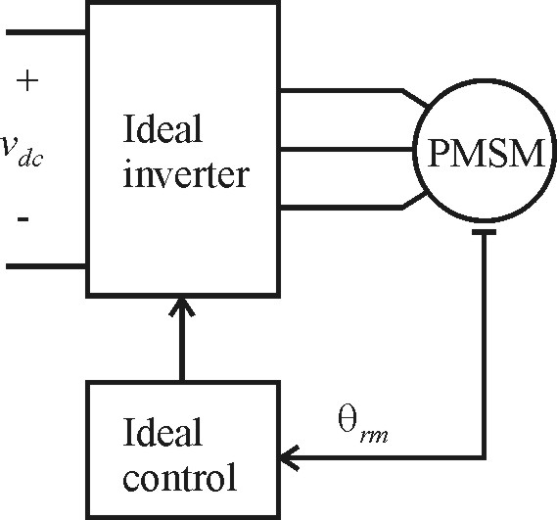
PMSM with Ideal Drive (Steady-State)
inverter voltages
resulting currents

Slide 23
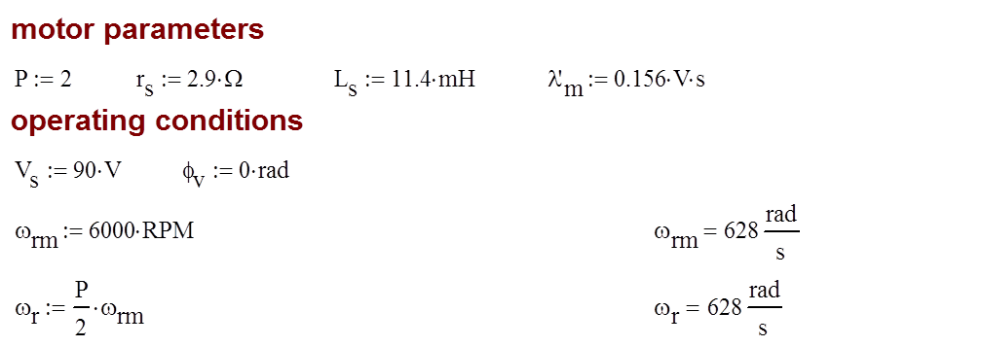
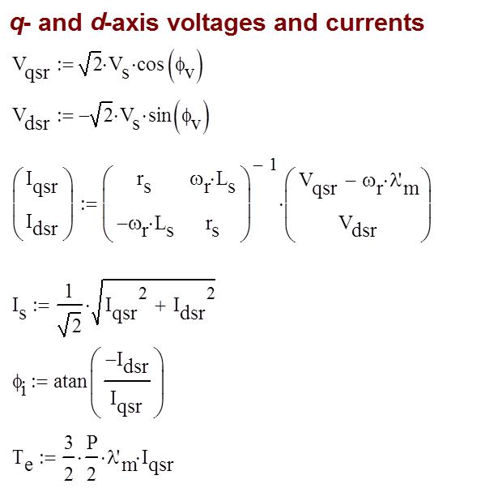
Ideal Drive Calculations with φ_{v} = 0

Slide 24
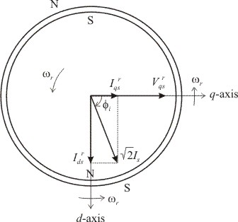
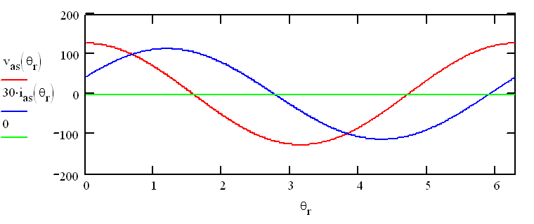
PMSM Steady-Sate Example φ_{v}=0

Slide 25
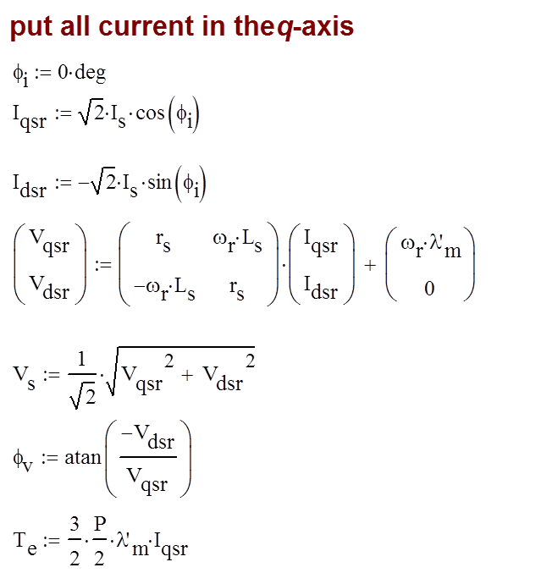
Ideal Drive Calculations with φ_{i} = 0

Slide 26
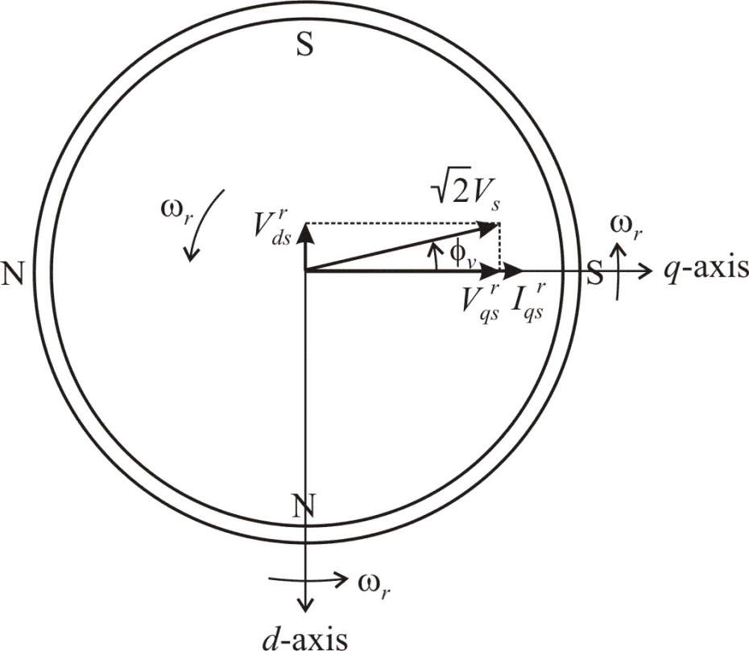
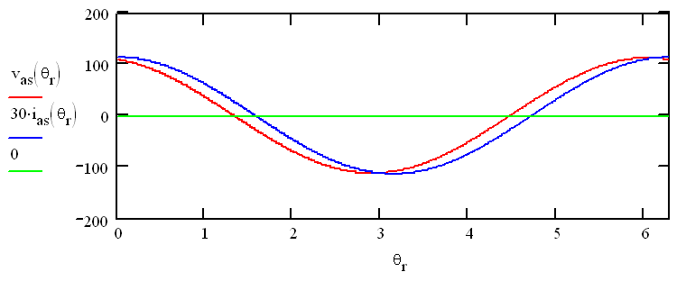
PMSM Steady-Sate Example with φ_{i} = 0

Slide 27
Maximizing Torque
Constant source voltage magnitude V_{s}
Adjusting source voltage phase φ_{v}
Maximum torque (from Chapter 6)
Adjust phase angle of voltage φ_{v} to achieve maximum possible torque regardless of current magnitude I_{s}

Slide 28
Maximum Torque (with Constant V_{s})
for maximum T_{e}

Slide 29
Example Calculations

Slide 30
Currents for φ_{v} = 0

Slide 31
Adjusting φ_{v} to Maximize Torque

Slide 32
Currents for Maximum Torque Operation

Slide 33
PMSM Steady-State Operation
Steady-state calculations are straightforward since q-d variables are constant in the rotor reference frame.
The PMSM drive adjust the applied voltages as a function of the measured rotor position angle.
Steady-state equations were used to observe PMSM drive performance.
The torque can be maximized as a function of speed by adjusting the phase angle of the applied voltages. This works because negative d-axis current weakens the rotor field yielding more torque at higher speeds. However, higher d-axis current also leads to higher power losses.

Slide 35
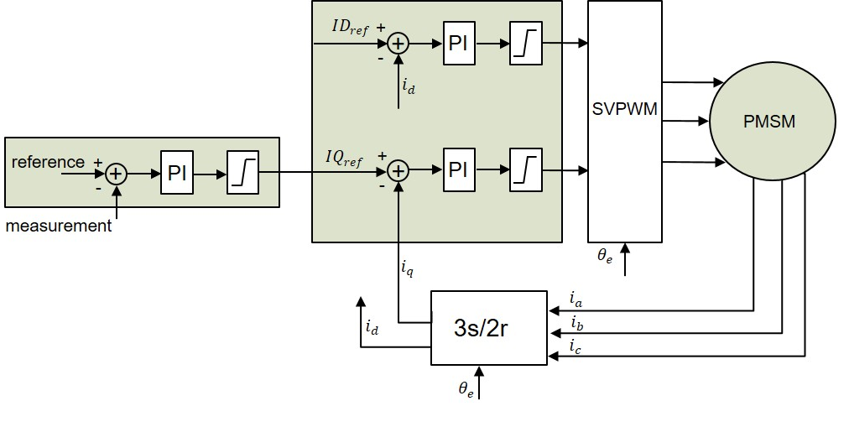

Slide 36













$$ID_{ref}$$
+
+
PI
-
$$i_{d}$$
SVPWM
PMSM
reference
$$IQ_{ref}$$
+
+
+
PI
+
PI
-
-
measurement
$$i_{q}$$
$${\hat{θ}}_{e}$$
$${\hat{ω}}_{m}$$
Kalman filter
$$i_{a}$$
3s/2r
$${\hat{θ}}_{m}$$
$$i_{d}$$
$$i_{b}$$
$${\hat{T}}_{l}$$
$$i_{c}$$
$$θ_{e}$$
$${\hat{θ}}_{e}$$

Slide 37




$$ID_{ref}$$
+
+
PI
-
$$i_{d}$$
SVPWM
PMSM
$$T_{e},θ_{m},ω_{m}$$
reference
$$IQ_{ref}$$
+
+
+
PI
+
PI
-
-
$$T_{e},θ_{m},ω_{m}$$
measurement
$$i_{q}$$
$$θ_{e}$$
$$i_{a}$$
3s/2r
$$i_{d}$$
$$i_{b}$$
$$i_{c}$$
$$θ_{e}$$
37

Slide 38







$$ID_{ref}$$
+
+
PI
-
$$i_{d}$$
SVPWM
PMSM
$$T_{e},θ_{m},ω_{m}$$
reference
$$IQ_{ref}$$
+
+
+
PI
+
PI
-
-
$$T_{e}$$
${\hat{ω}}_{m}$, ${\hat{θ}}_{m}$
$\text{measurement}$or
$$i_{q}$$
$${\hat{θ}}_{e}$$
$${\hat{ω}}_{m}$$
Kalman filter
$$i_{a}$$
3s/2r
$${\hat{θ}}_{m}$$
$$i_{d}$$
$$i_{b}$$
$${\hat{T}}_{l}$$
$$i_{c}$$
$$θ_{e}$$
$${\hat{θ}}_{e}$$
38

Slide 39

$$ID_{ref}$$
+
+
PI
-
$$i_{d}$$
SVPWM
PMSM
$$T_{e},θ_{m},ω_{m}$$
reference
$$IQ_{ref}$$
+
+
+
PI
+
PI
-
-
$$T_{e}$$
${\hat{ω}}_{m}$, ${\hat{θ}}_{m}$
$\text{measurement}$or
$$i_{q}$$
$${\hat{θ}}_{e}$$
Kalman filter
$$i_{a}$$
3s/2r
$$i_{d}$$
$$i_{b}$$
$$i_{c}$$
$${\hat{θ}}_{e}$$
Machine measurements
39
39

Slide 40
$$ID_{ref}$$
+
+
PI
-
$$i_{d}$$
SVPWM
PMSM
$$T_{e},θ_{m},ω_{m}$$
reference
$$IQ_{ref}$$
+
+
+
PI
+
PI
-
-
$$T_{e}$$
${\hat{ω}}_{m}$, ${\hat{θ}}_{m}$
$\text{measurement}$or
$$i_{q}$$
$${\hat{θ}}_{e}$$
Dynamic
Observer
$$i_{a}$$
3s/2r
$$i_{d}$$
$$i_{b}$$
$$i_{c}$$
$${\hat{θ}}_{e}$$
Machine measurements
40
40
40

